Slide 1
SONiC Management Framework –Proposal

Slide 2
Framework High-level Requirements
Provide an Infrastructure for UI development for SONiC, including some client UIs
Support smooth integration of a variety of Standards-based and proprietary data models
Standard YANG models (e.g. OpenConfig, IETF, IEEE)
Industry-standard CLI feel (details TBD)
Support easy integration of OpenAPI server-side implementations
Multiple protocols/Interfaces, including concurrency between them: -
CLI
gNMI
REST/RESTCONF
SNMP
NETCONF
Unified security using standard network services (e.g. RADIUS, TACACS+, LDAP)
Authentication - including certificate-based
Authorization - Role-based
Ease of use for developer workflow
Specify data model and auto-generate as much as possible from there
Fit with existing SONiC Architecture and Management
Co-exist with what exists today - backward compatibility
Don’t place additional requirements upon existing features and infrastructure
Support Validation and Error Handling - data model, platform capability/scale, dynamic resources
Packageable – SONiC users can pick and choose only the pieces they need

Slide 3
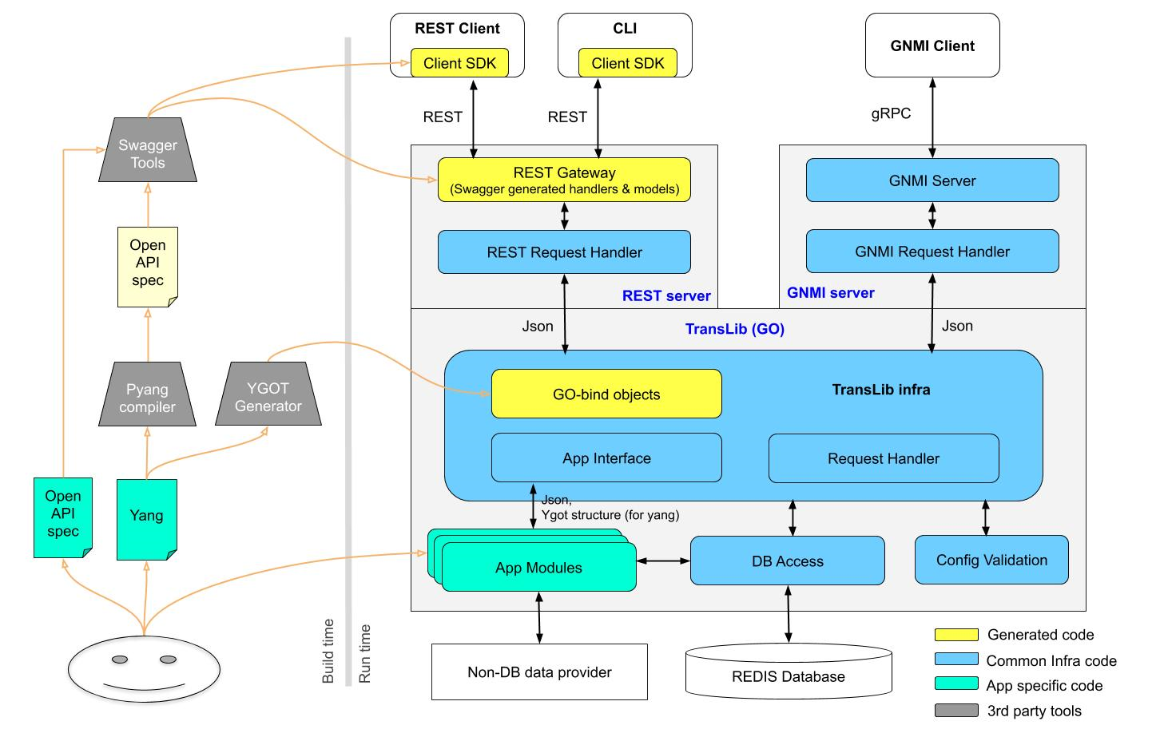
Design

Slide 4
Config Validation Library
Platform Specific Data
ABNF JSON
ABNF Schema
Config Validation Library
Translator
(to YANG XML)
YANG Schema with metadata
Syntax Check
Use cases :
Startup config (config_db.json) validation
Key and Payload validation for CRUD operations inside TransLib
Key and field(s) validation from other application like Click based Python CLI
Pyang Compiler
YANG Schema with metadata
Semantic Check
Custom Validation
Platform check
Build Time
Run Time
Redis DB
Common code
Third party
Generated code
Feature specific custom code
Manually written

Slide 5
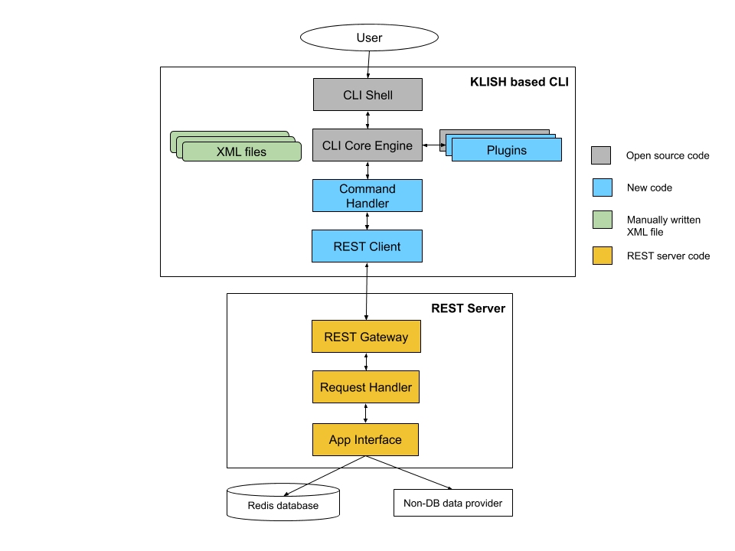
CLI Design

Slide 6
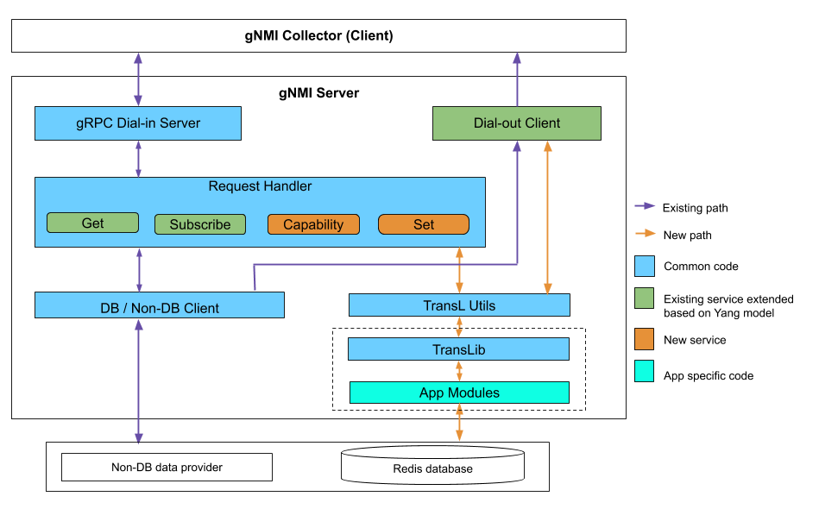
gNMI Server Integration

Slide 7
Backup

Slide 8
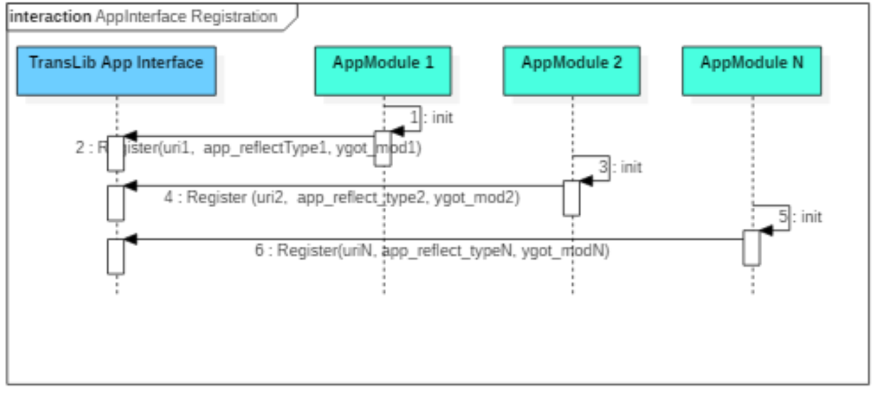
App Registration

Slide 9
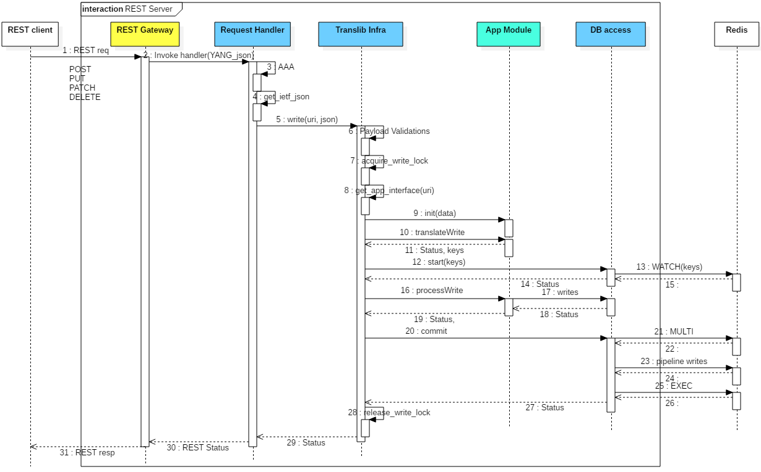
REST SET Operation

Slide 10
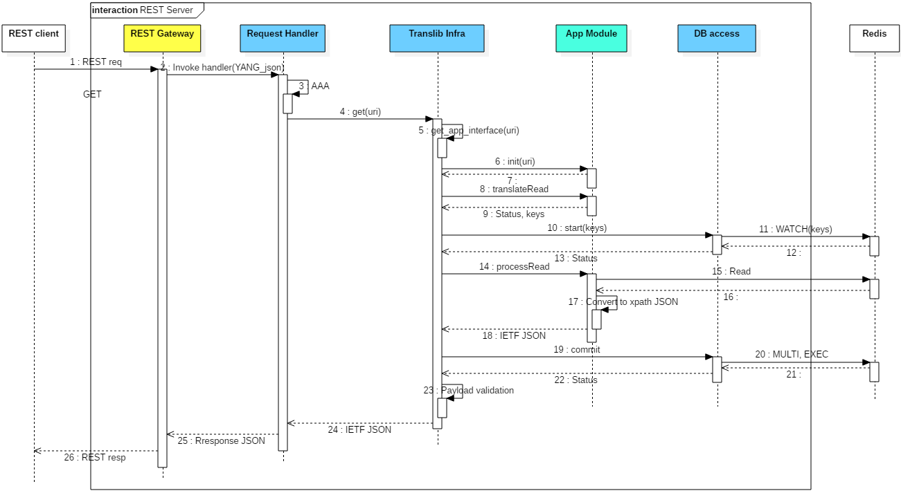
REST GET Operation

Slide 11
Approach
TransLib - Library for Management application servers
REST server, gNMI server and TransLib all in GO
Marshalling and unmarshalling using YGOT
Concurrent writes from different management applications without lock
Integration into KLISH based CLI framework
Config validation

Slide 12
Design contd ...
Pyang Compiler
An extensible YANG validator and OpenAPI Spec generator.
YGOT Generator
Collection of Go utilities for generating Go Structures, validating contents in the Go structures, rendering Go Structure to output format such as JSON.
Swagger Tool
Generates Client SDK, Server Stub and API documentation based on OpenAPI Spec.
Client SDK
Swagger generated APIs used to communicate with REST server from a REST client/CLI.
REST Gateway (Server)
GO based REST server generated using swagger.
REST Request Handler
All REST requests from Northbound land here
Invokes common handler for CRUD operations with path and Payload
Calls appropriate Translib functions based on CRUD operation.
GNMI Server
Existing GNMI server in SONiC extended for YANG based support
GNMI Request Handler
Handles Set/Get/Subscribe/Capability request.
Calls appropriate Translib functions based on requested operation

Slide 13
Design contd ...
TransLib (GO)
GO based Translation library to convert data in YANG to Redis(ABNF) format and vice versa, validate config data and write to Redis/Non-DB database.
Translib Infra
GO bind-Objects
GO bindings generated using YGOT. Converts the incoming payload to YGOT structures, which is given to App modules
Request Handler
All requests from management servers land here.
App Interface
App modules registers with it dpathng TransLib initialization
Invokes appropriate app module specific implementation
App Modules
YGOT structure to ABNF key value pairs - write, ABNF key value pairs to YGOT structure - read
Translates, validates and converts data.
Facilitates breaking bulk operation into multiple operations suitable for Redis transaction
DB Access
Provides access to Redis DB using Go-Redis package
Supports transaction
Config Validation
Validates a JSON buffer against given ABNF schema. Carries-out semantic, syntactic, parameter, type and range validation as well as platform and inter-dependency validation. Uses code generated from a schema definition

Slide 14
Config Validation Library
ABNF JSON:
{
"VLAN_MEMBER": {
"Vlan100|Ethernet24": {
"tagging_mode": "tagged"
},
"Vlan100|Ethernet28": {
"tagging_mode": "untagged"
},
}
module: sonic-vlan
+--rw VLAN* [name]
| +--rw name string
| +--rw vlanid? uint16
| +--rw members* -> /sif:PORT_TABLE/ifname
+--rw VLAN_MEMBER* [name ifname]
+--rw name -> ../../VLAN/name
+--rw ifname -> /sif:PORT_TABLE/ifname
+--rw tagging_mode? scommon:tagging_mode
YANG XML:
<VLAN_MEMBER>
<name>Vlan100</name>
<ifname>Ethernet24</ifname>
<tagging_mode>tagged</tagging_mode>
</VLAN_MEMBER>
<VLAN_MEMBER>
<name>Vlan100</name>
<ifname>Ethernet28</ifname>
<tagging_mode>untagged</tagging_mode>
</VLAN_MEMBER>

Slide 15
gNMI Integration
Approach :
If path ‘Prefix’ is any of known DB name like APP_DB, CONFIG_DB etc., existing data client is created.
For other cases, new TransL data client is created.
TransL data client uses TransL Utils functions.
TransL Utils functions invoke APIs provided by TransLib library.
TransLib API creates thread internally per client subscription which listens for Redis notification. The notification data is received by TransL data client through.
Code organization:
├── dialout
│ ├── dialout_client
│ │ ├── dialout_client.go ⇒ Modified
│ │ └── dialout_client_test.go
│ ├── dialout_client_cli
│ └── dialout_client_cli.go
├── gnmi_server
│ ├── client_subscribe.go ⇒ Modified
│ ├── server.go ⇒ Modified
│ └── server_test.go
├── sonic_data_client
│ ├── db_client.go
│ ├── non_db_client.go
│ ├── transl_client.go ==> Added TransL data client
│ ├── trie.go
│ └── virtual_db.go
└── transl_utils
└── transl_utils.go ==> Added TransL Utils Layer

